Slide 1
Project summary

Slide 2
DRUG | 100nM | 300nM | 1000nM | 3000nM Ok.20% vitality | 10000nM Cells are dead
Drug2 | Ok | Ok | Ok | ----------------- | -----------------
Drug4 | Ok | Ok | Ok | ----------------- | -----------------
Drug6 | Ok | Ok | Ok | ----------------- | -----------------
Drug7 | Ok | Ok | Ok | Ok.50% vitality | -----------------
Drug10 | ok | ok | ok | ----------------- | -----------------

Slide 3
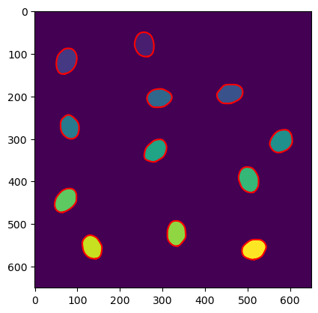
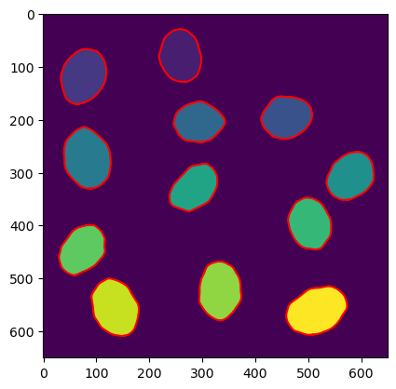
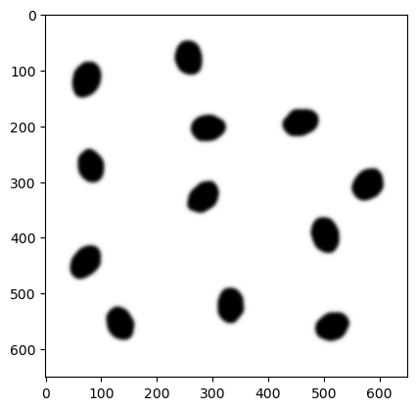
- gaussian filter, - histogram visualization - treshold choose - watersheld -different values for each cel – thats how we can differentiate tchem - regionprops function – to calculate amount of cells/nuclei, masks to calculate cell/nuclei size (sum of pixels with given value), intensity – mask + oryginal channel green → mean value of pixels in given cell

Slide 4
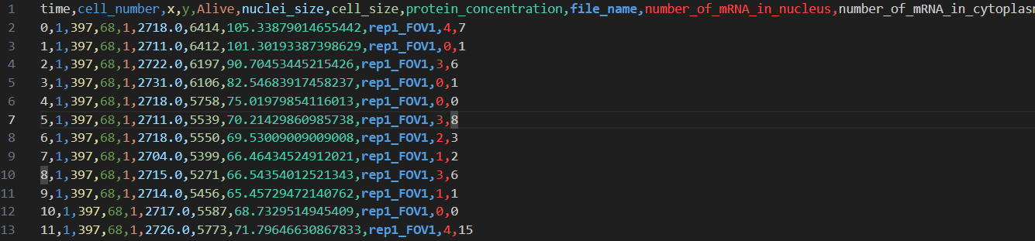
Our table with data

Slide 5
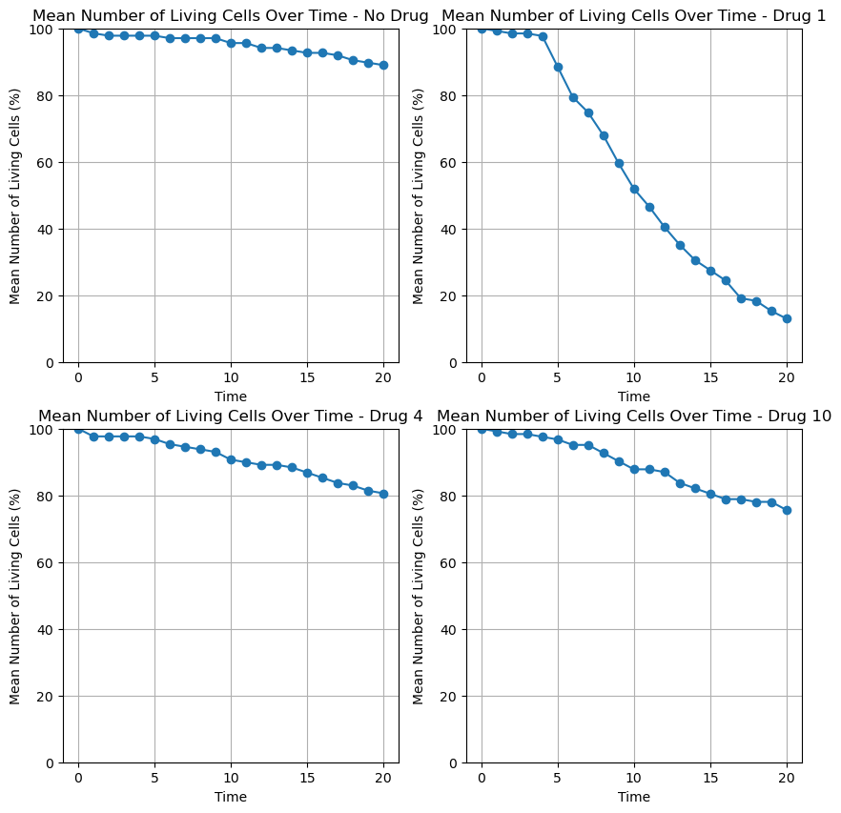

Slide 6
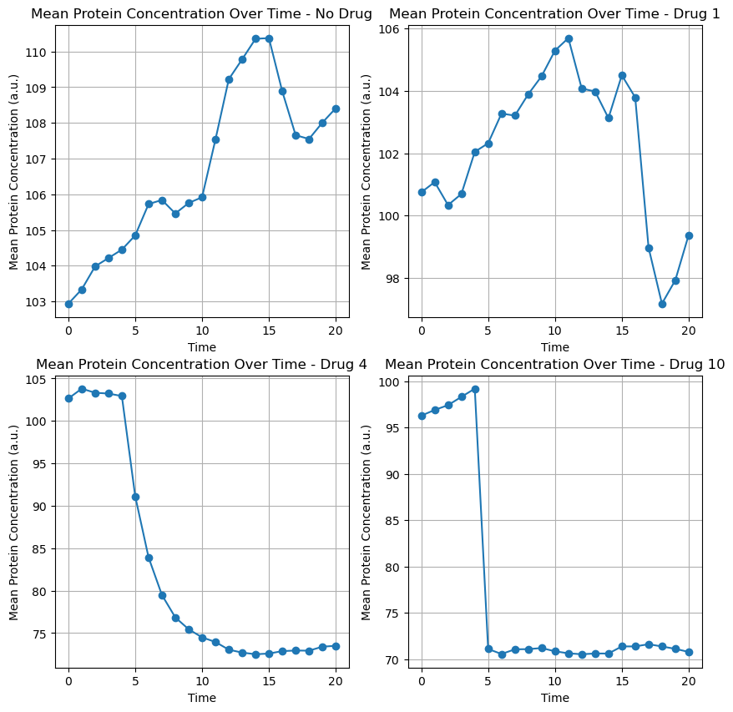

Slide 7
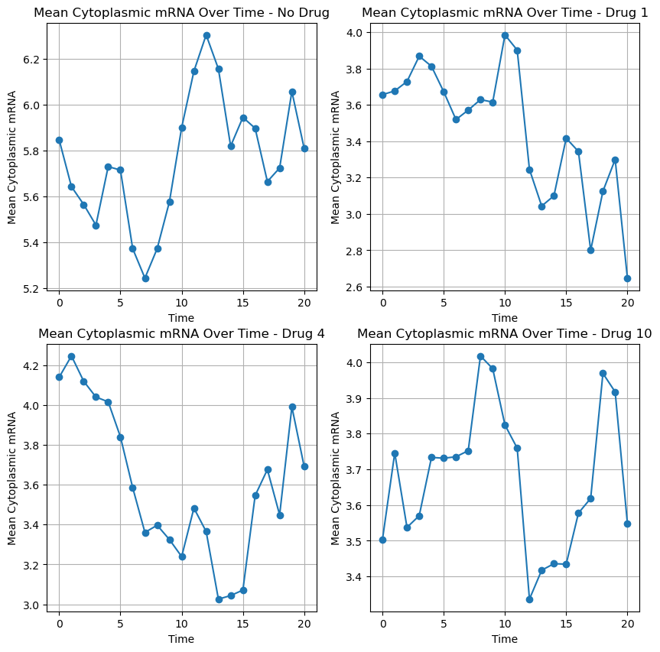

Slide 8
